Slide 1
A core Course on Modeling
Introduction to Modeling
0LAB0 0LBB0 0LCB0 0LDB0
c.w.a.m.v.overveld@tue.nl
v.a.j.borghuis@tue.nl
S.19

Slide 2
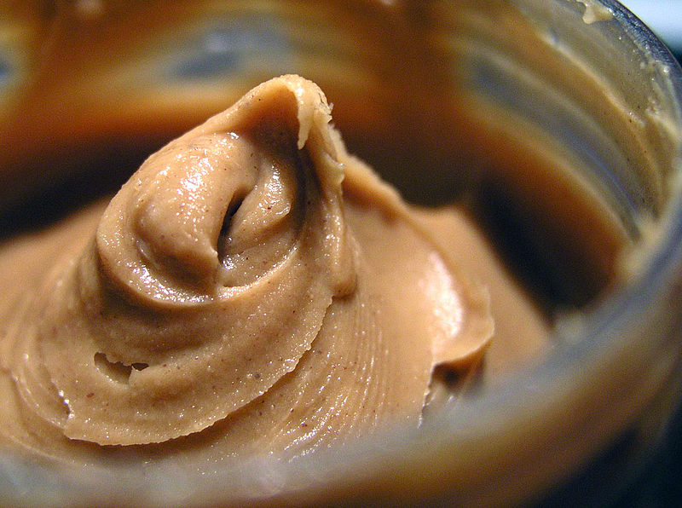
Example 3:
“How can we get rich
selling peanut butter?”
http://commons.wikimedia.org/wiki/File:PeanutButter.jpg
Notes:
2

Slide 3
relations
dimensions
assumptions
todo
profit = income - expenses
[Euro / year] = [Euro/year]
no taxes, no inflation
profit
income
expenses
pricePerItem
nrSoldItems
nrSoldTotal
marketShare
income =
pricePerItem * nrSoldItems
[Euro / year] =
[Euro/myPB] * [myPB/year]
no discount with larger quantities per purchase
nrSoldItems =
nrSoldTotal * marketShare
[myPB / year] =
[allPB / year] * [myPB/allPB]
my PB will not increase the total market
nrSoldTotal = 2x10⁷ [allPB/year]
http://www.watnouweg.nl/nieuws/nieuwsitem.php?id=348&back=1&page=29
pricePerItem = …
marketShare = …
Notes:
3

Slide 4
Dependency:
how does marketShare
depend on pricePerItem?
http://www.sxc.hu/browse.phtml?f=download&id=366244
Notes:
4

Slide 5
Approach 1: Glass Box
?
marketShare
1
0
pricePerItem
Notes:
5

Slide 6
QUIZ
How does market share depend on price per item?
How can this relation be expressed in a mathematical formula?
Notes:
6

Slide 7
Approach 1: Glass Box
?
marketShare
1
0
pricePerItem
What mechanism determines marketShare(pricePerItem)?
monotonically decreasing
between 0 and 1
asymptote: marketShare→0 if pricePerItem →∞
asymptote: marketShare→1 if pricePerItem →- ∞
what sort of mathematical dependency ???
Notes:
7

Slide 8
1st guess: straight lines
advantage: simple
disadvantage: not smooth
uncertain if this follows the actual behavior
Approach 1: Glass Box
cheapest
competitor
most expensive
competitor
marketShare
1
0
pricePerItem
What mechanism determines marketShare(pricePerItem)?
monotonically decreasing
between 0 and 1
asymptote: marketShare→0 if pricePerItem →∞
asymptote: marketShare→1 if pricePerItem →- ∞
what sort of mathematical dependency ???
Notes:
8

Slide 9
2nd, 3rd guess: arctan, logistic, …?
advantage: smooth
disadvantage: more parameters?
what values for the parameters?
uncertain if this follows the actual behaviour
Approach 1: Glass Box
cheapest
competitor
most expensive
competitor
marketShare
1
0
pricePerItem
What mechanism determines marketShare(pricePerItem)?
monotonically decreasing
between 0 and 1
asymptote: marketShare→0 if pricePerItem →∞
asymptote: marketShare→1 if pricePerItem →- ∞
what sort of mathematical dependency ???
Notes:
9

Slide 10
Approach 2: Black Box
cheapest
competitor
most expensive
competitor
marketShare
1
0
pricePerItem
What mechanism determines marketShare(pricePerItem)?
monotonically decreasing
between 0 and 1
asymptote: marketShare→0 if pricePerItem →∞
asymptote: marketShare→1 if pricePerItem →- ∞
what sort of mathematical dependency ???
Notes:
10

Slide 11
Approach 2: Black Box
ask a panel if they would pay € ... for your PB
cheapest
competitor
most expensive
competitor
marketShare
1
0
pricePerItem
What mechanism determines marketShare(pricePerItem)?
monotonically decreasing
between 0 and 1
asymptote: marketShare→0 if pricePerItem →∞
asymptote: marketShare→1 if pricePerItem →- ∞
what sort of mathematical dependency ???
Notes:
11

Slide 12
Approach 2: Black Box
ask a panel if they would pay € ... for your PB
cheapest
competitor
most expensive
competitor
marketShare
1
0
pricePerItem
What mechanism determines marketShare(pricePerItem)?
monotonically decreasing
between 0 and 1
asymptote: marketShare→0 if pricePerItem →∞
asymptote: marketShare→1 if pricePerItem →- ∞
what sort of mathematical dependency ???
Notes:
12

Slide 13
Summary:
while making a model:
encouter a new quantity
ask: what does it depend on
ask: how does the dependency look like
Notes:
13

Slide 14
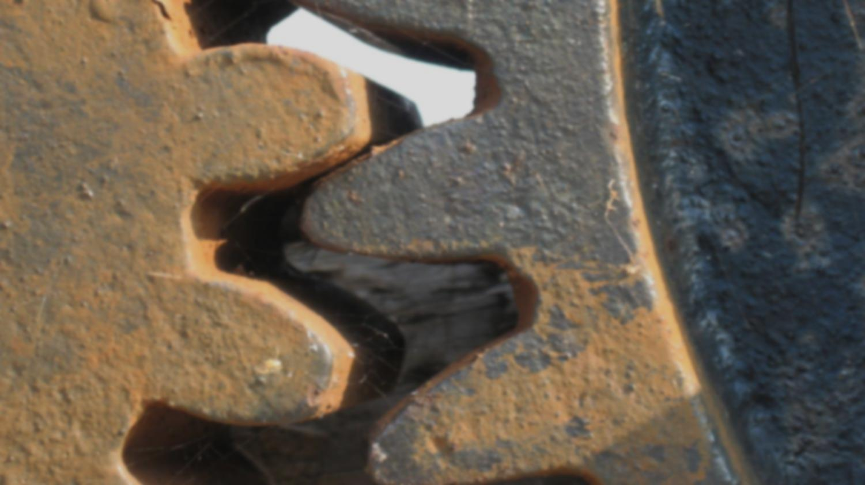
Summary:
while making a model:
encouter a new quantity
ask: what does it depend on
ask: how does the dependency look like
known or assumed mechanism: glass box
http://www.sxc.hu/browse.phtml?f=download&id=596438
Notes:
14

Slide 15
Summary:
while making a model:
encouter a new quantity
ask: what does it depend on
ask: how does the dependency look like
known or assumed mechanism: glass box
measure or guessed data: black box
data may need a smooth interpolation
http://www.sxc.hu/browse.phtml?f=download&id=36217
Notes:
15

